Slide 1
Capstone Project – 2
Bike Sharing Demand Prediction by- Team zlearners :- Akshit Singh Mishra Om

Slide 2
Agenda
Look at the problem statements
Study the dataset
Looking for null/duplicate values
E.D.A and visualization
Look at the correlation among variables
Regression models and evaluation metrics for the model
Hyperparameter tuning
Model comparison
Conclusion

Slide 3
Approach
Understanding Business problem
Data collection & Preprocessing
- Data cleaning
- Missing Data Handling
Exploratory Data Analysis
- Understanding categorical and numerical features
- EDA conclusion
Data manipulation
- Feature Engineering
- Outlier Detection & Treatment
- Feature scaling
- Categorical Data encoding
Modelling
- Train Test split
- Fitting models to a Data
- Hyperparameter Tuning
Model Performance & Evaluation
- Visualizing Model Performance
- Base models v/s Tuned models
Conclusion and Recommendations

Slide 4
Problem Statement
At present rental bikes are presented in numerous metropolitan urban cities to improve portability solace. It is essential to make the rental bikes accessible and open to general society as it reduces the waiting time. Ultimately, furnishing the city with a stable stock of rental bikes becomes a main pressing issue. The essential part is predicting the bike count expected every hour for the steady inventory of rental bikes.

Slide 5
Data Summary
There are around 9,000 observations with various types of field in our Dataset.
List of columns:-
Date (dd/mm/yyyy) | Solar radiation (MJ/m2)
Rented Bike Count | Rainfall (mm)
Hour | Snowfall (cm)
Temperature (°C) | Seasons
Humidity (%) | Holiday
Windspeed (m/s) | Functioning Day
Visibility (10m)
Dew point temperature (°C)

Slide 6
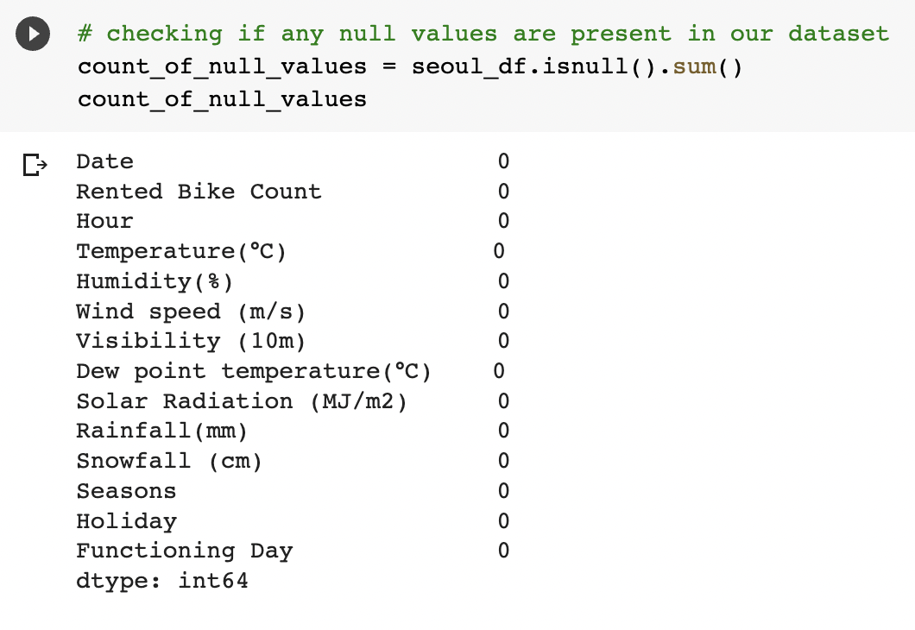
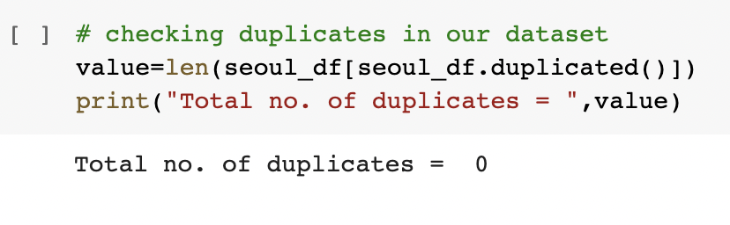
Null and duplicate values
There are no null/missing values present in our dataset.
No duplicates are found in the dataset.

Slide 7
Exploratory Data Analysis

Slide 8
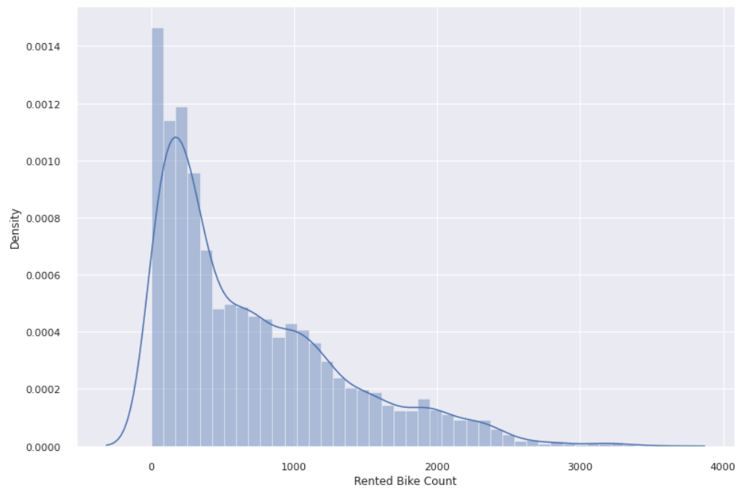
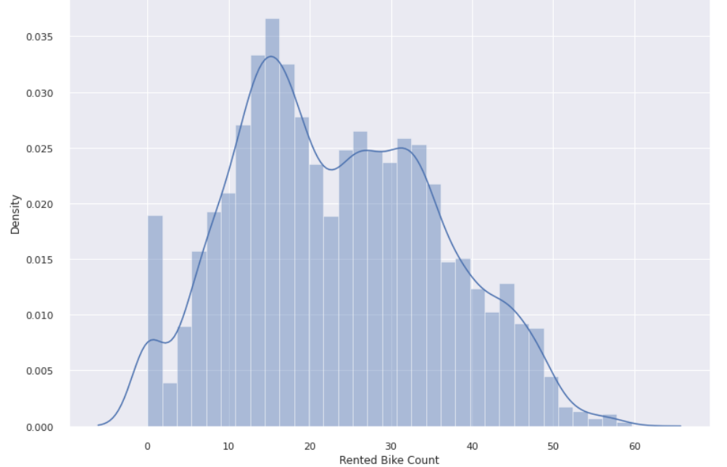
Dependent variable (Rented Bike Count) -
The graph suggests that rented bike count has positive skewness.
It is removed using square-root transformation

Slide 9
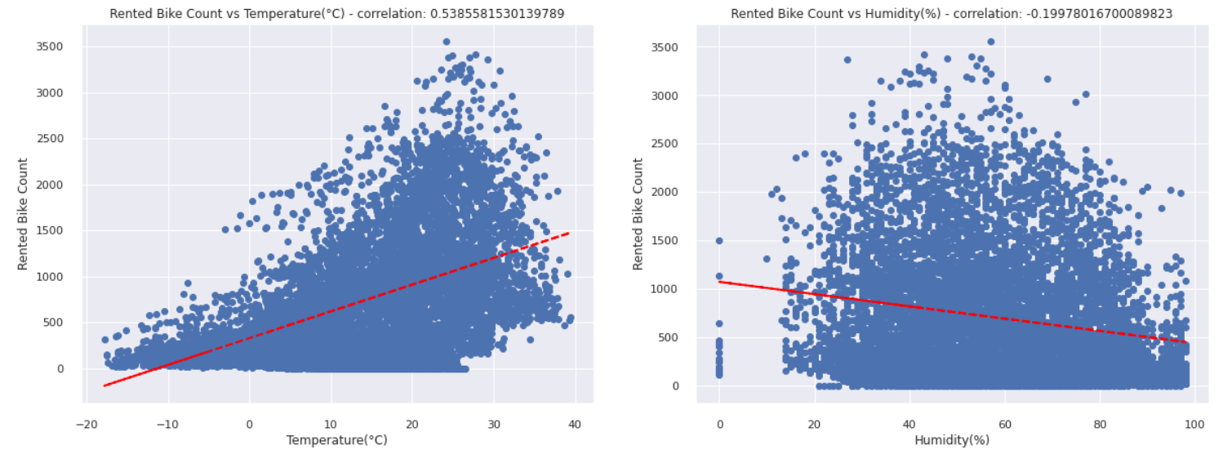
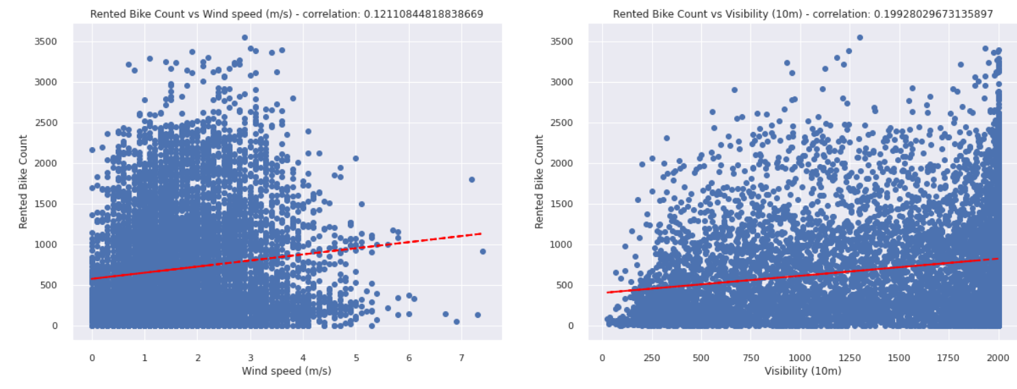
Relationship between dependent and independent variables

Slide 10
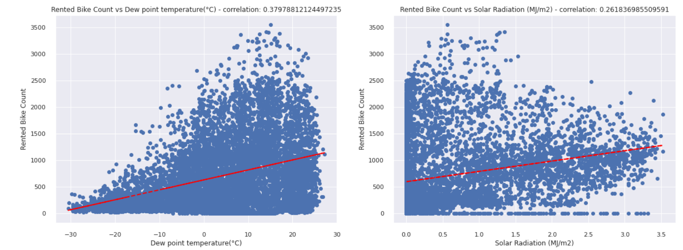
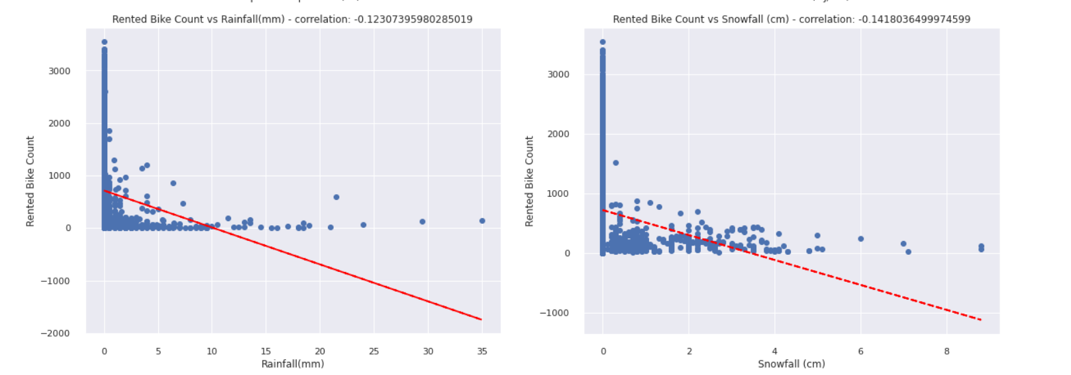

Slide 11
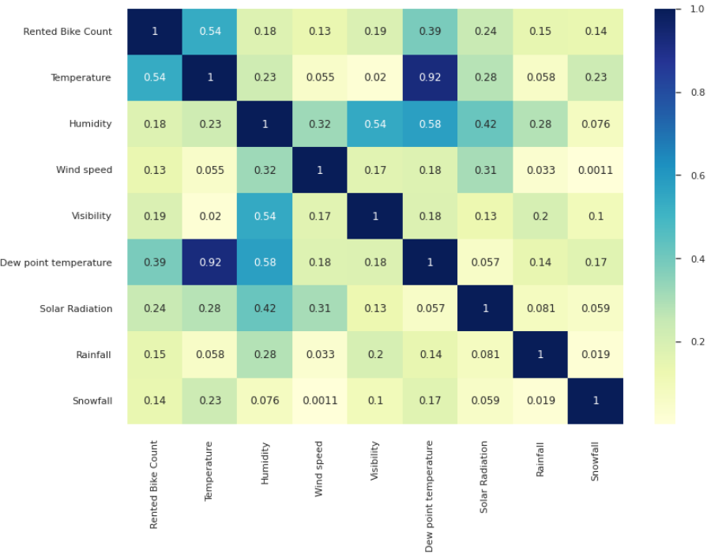
Heatmap
There is a high correlation between Temperature and Dew point temperature with a value of 0.92.
Temperature has the highest correlation value with Rented Bike Count followed
by Dew point temperature.
Humidity has a moderate correlation with Visibility and Dew point temperature.

Slide 12
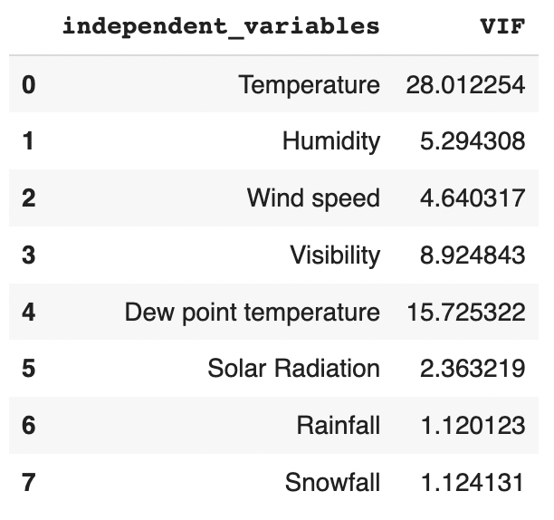
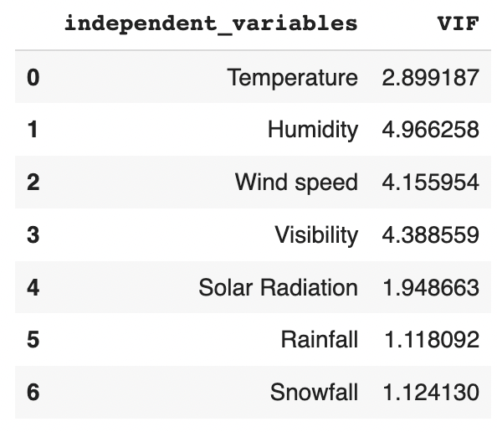
Checking multicollinearity
Temperature and Dew point temperature have high VIF values.
The VIF values for all the features are less than 5 after removing Dew point temperature.

Slide 13
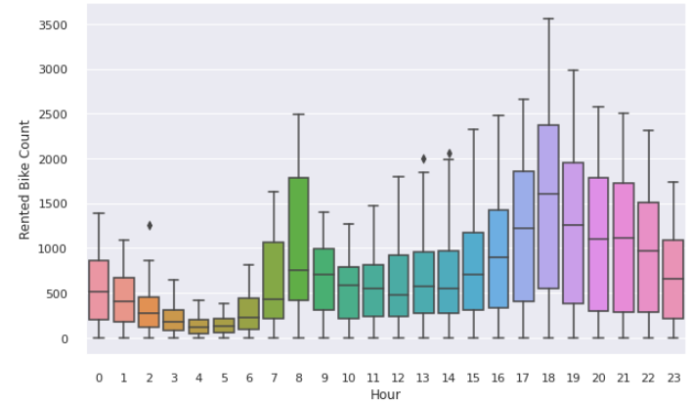
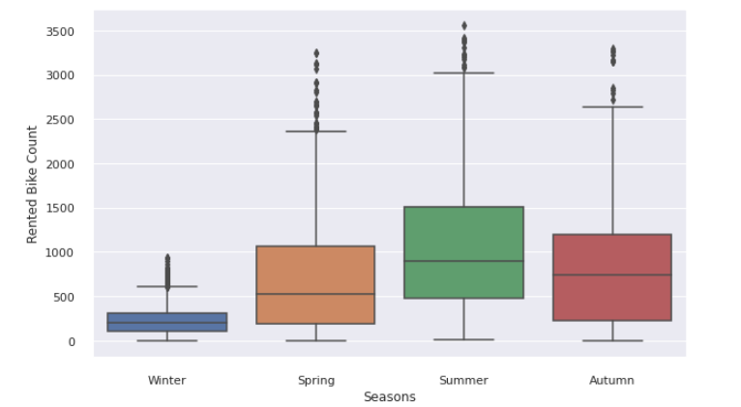
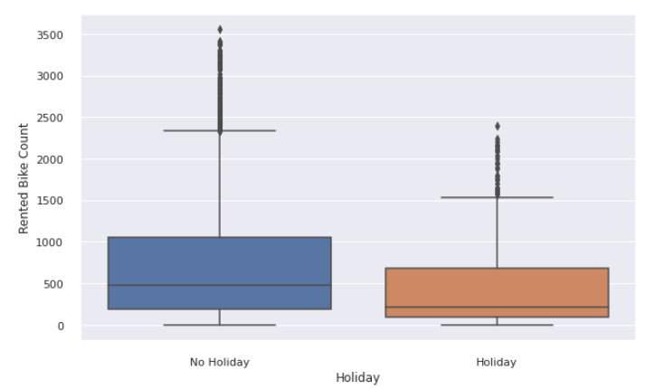
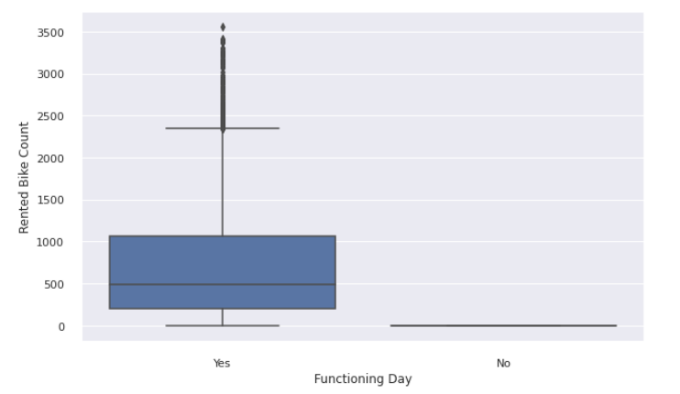
Understanding Categorical features

Slide 14
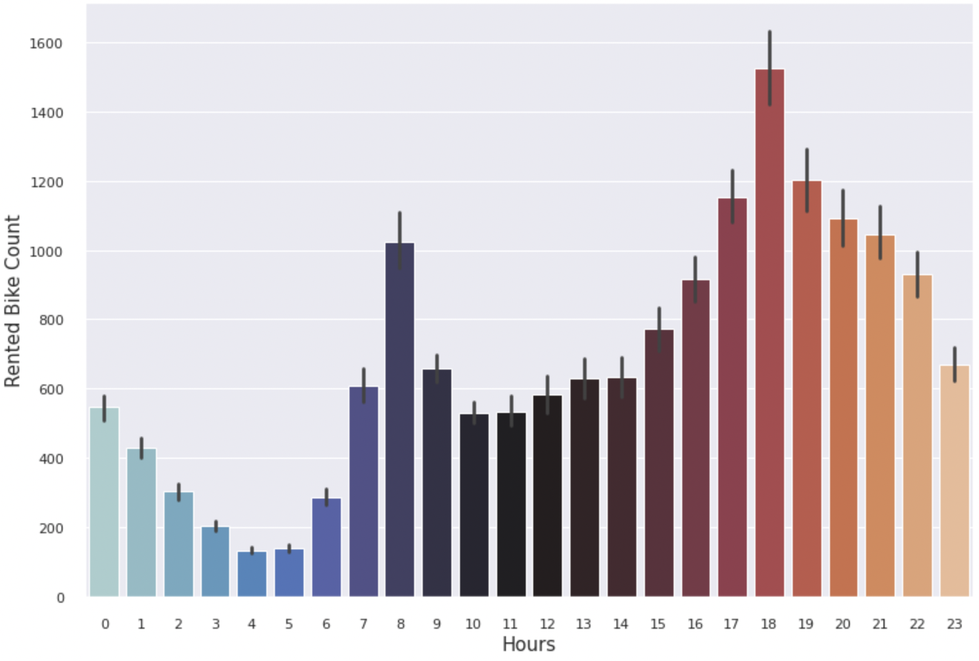
Number of rented bikes for each hour
The bikes are in high demand in the evening with a peak time at 6 pm.
The demand is high at 8 am in the morning as well.
People generally use rented bikes in the course of their operating hours i.e. from 7 am to 9 am and 5 pm to 7 pm.

Slide 15
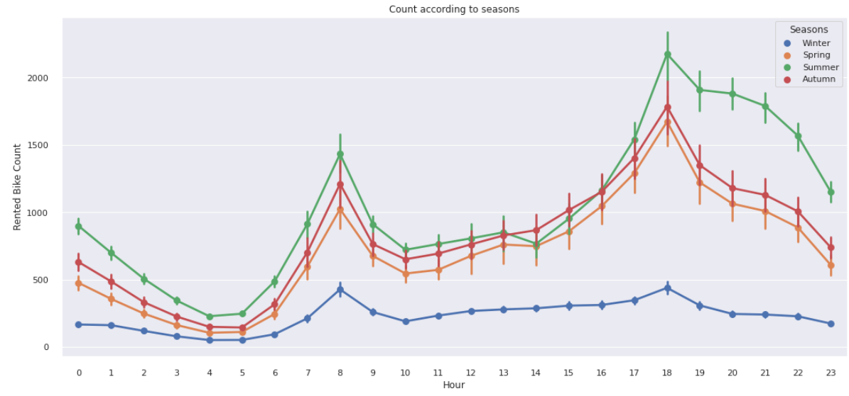
Demand of bikes according to seasons
The demand for rented bikes is high in summer with the peak time of 7-9 AM & 5-7 PM followed
by Autumn.
The demand is least in the winter season (due to snowfall which is negatively correlated with our
target variable).

Slide 16
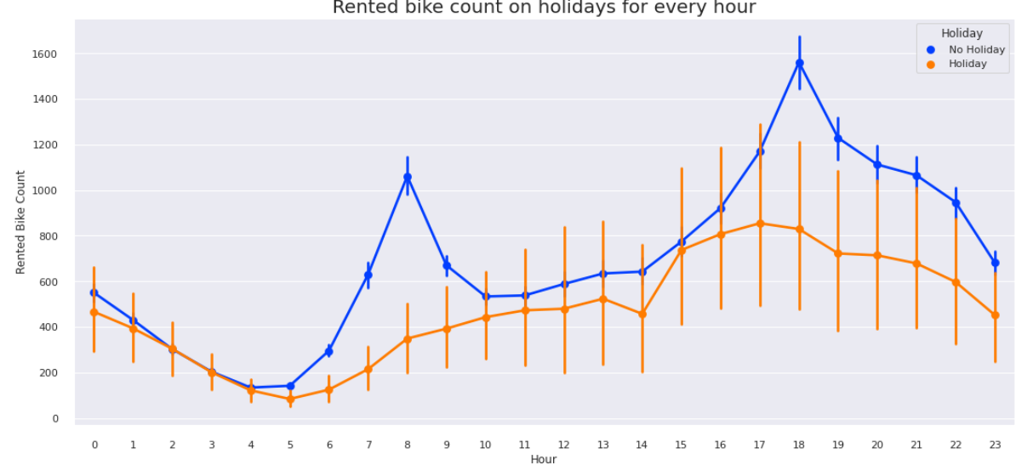
Rented bike count on holidays for every hour
When there are no holidays, two spikes can be seen one at 8 am and one at 6 pm. So in the morning and evening, the demand for rented bikes is high.
When there are holidays the demand is low during the entire day.

Slide 17
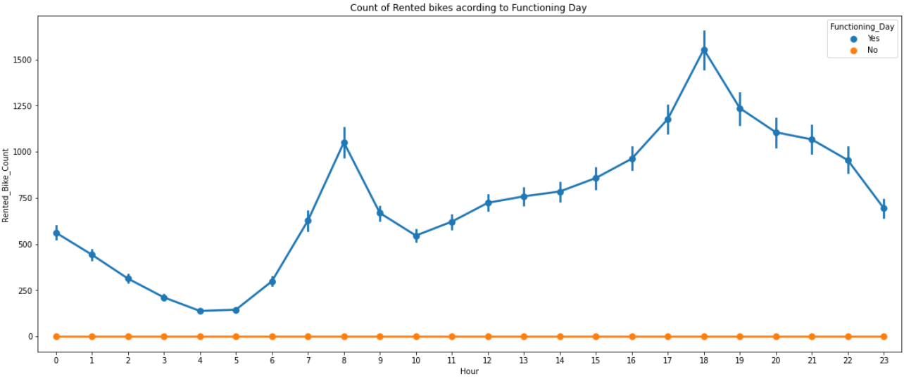
Rented bike count on functioning days for every hour
From the above plot we can see that rented bike count is high on functioning days whereas it is zero on non-functioning data.

Slide 18
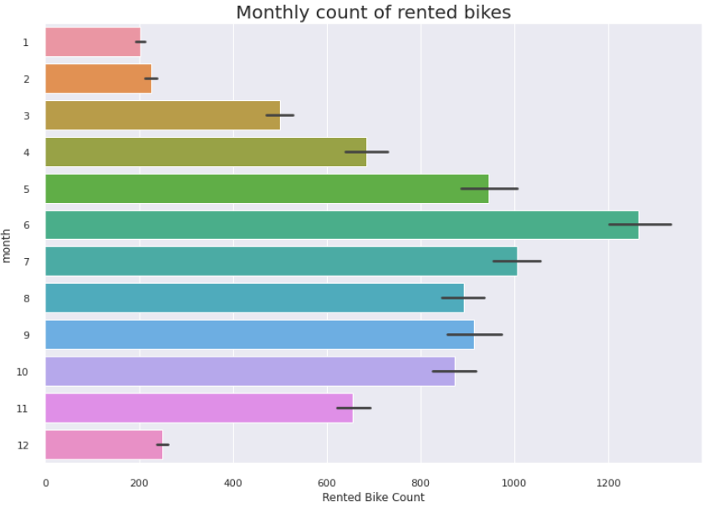
Monthly count of rented bikes
During the month of June, the demand for bikes is high followed by July and May.
Demand is lowest in December, January and February.

Slide 19
ML Regression Algorithms
Linear Regression
Polynomial Regression
Lasso Regression
Ridge Regression
Elastic-net Regression
Decision Tree
(we have also perform Hyperparameter Tuning to improve our model performance)

Slide 20
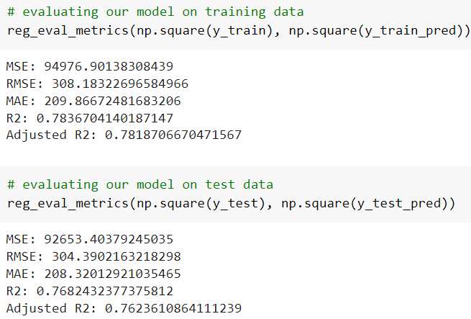
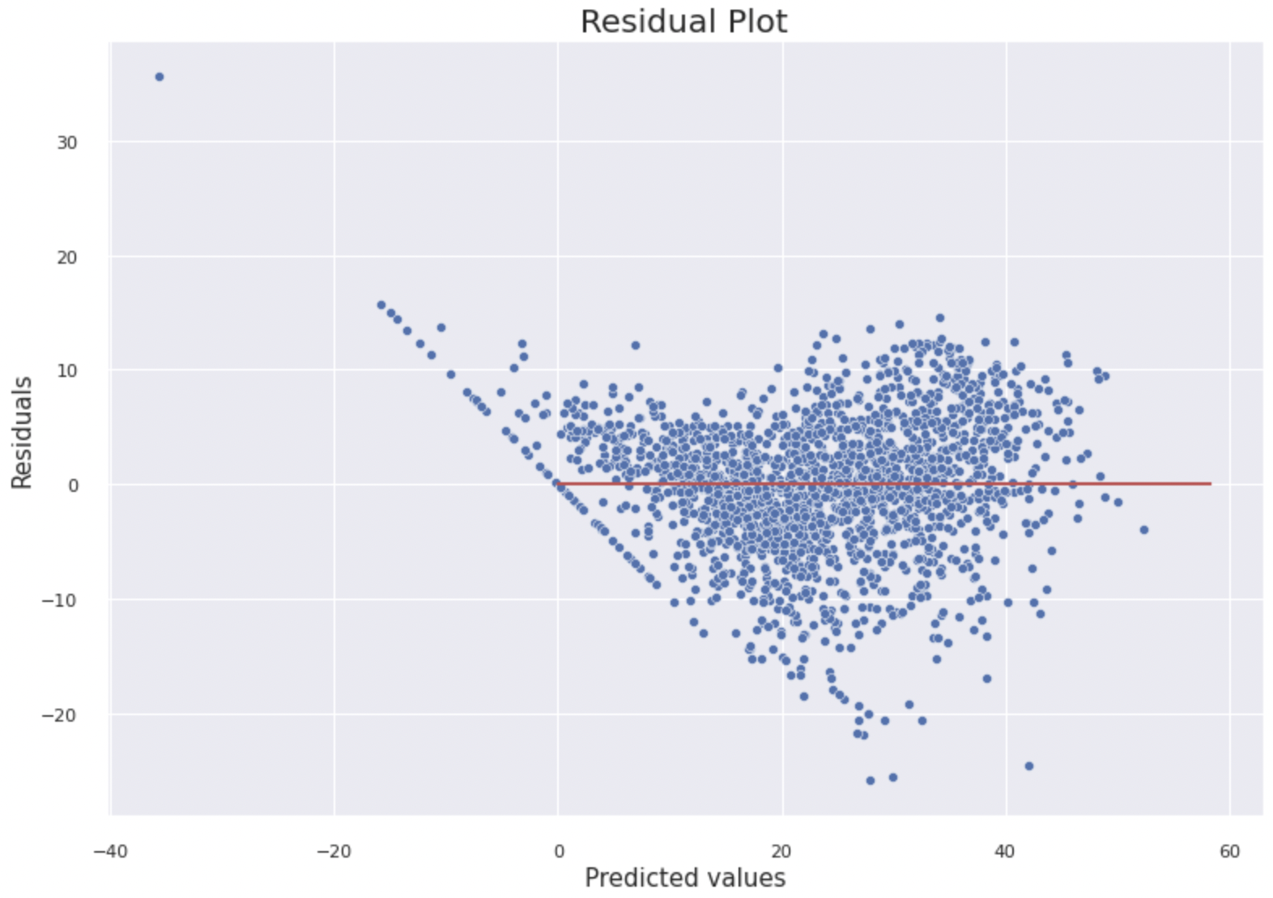
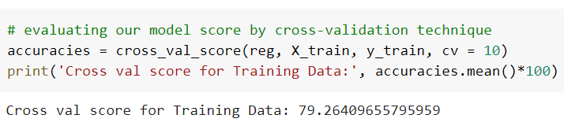
Linear regression

Slide 21
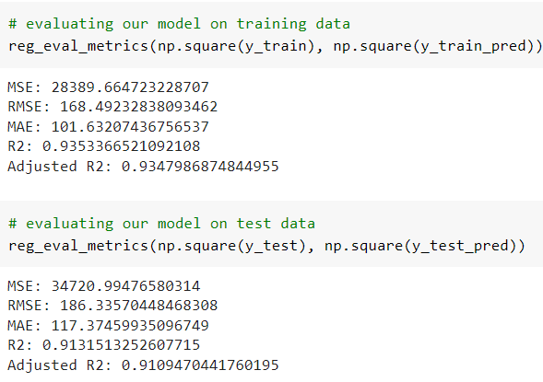
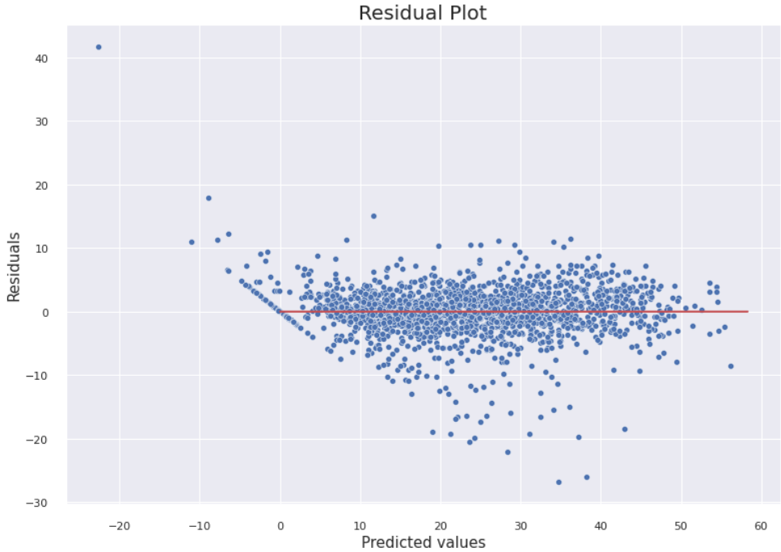
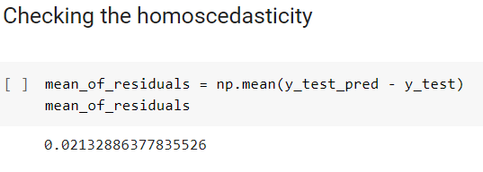
Polynomial Regression

Slide 22
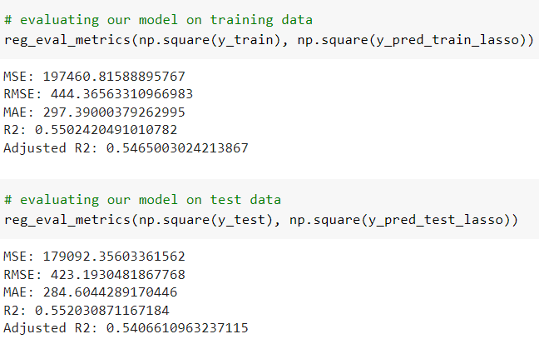
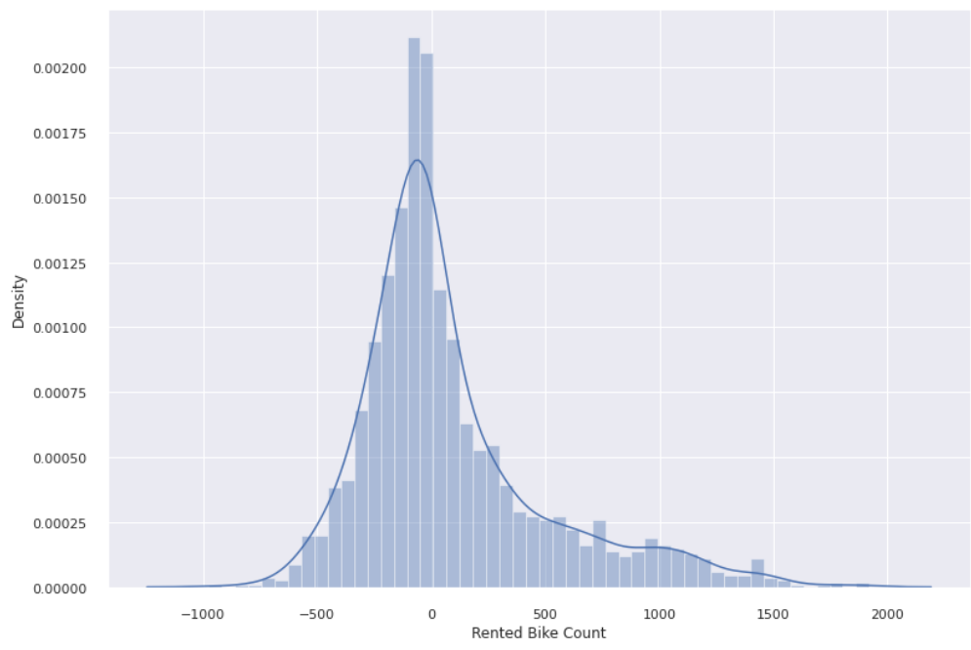
Lasso regression
R2 score is quite low.
The distribution is positively skewed.

Slide 23
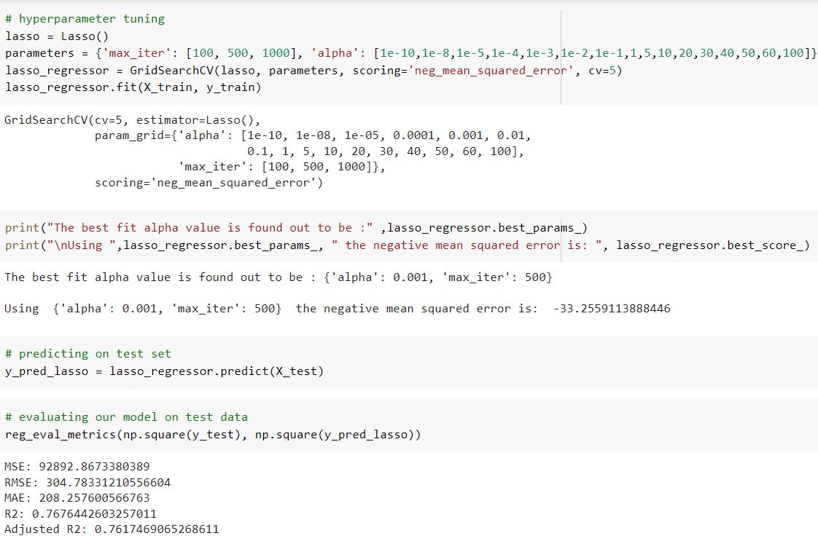
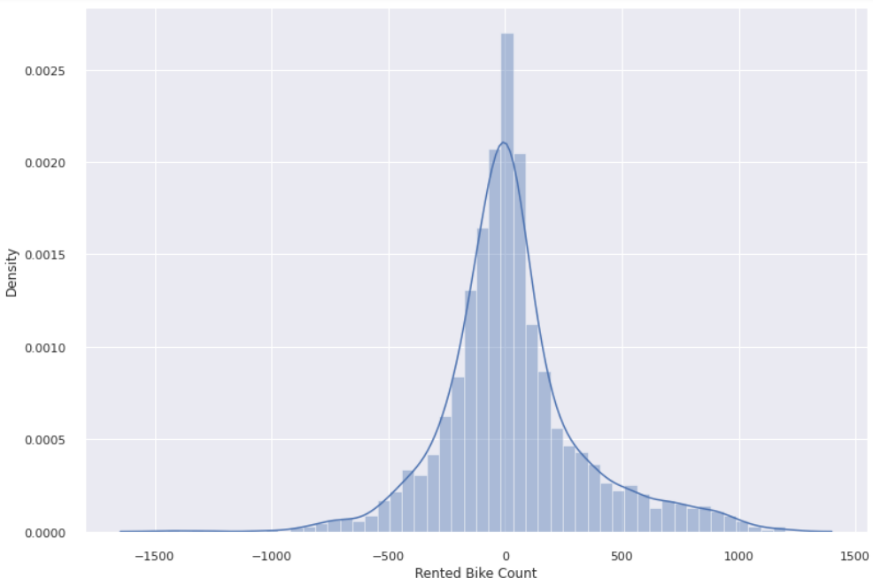
Hyperparameter Tuning on Lasso Regression
RMSE and MAE are reduced significantly for lasso regression.
R2-score has been increased by 20%.

Slide 24
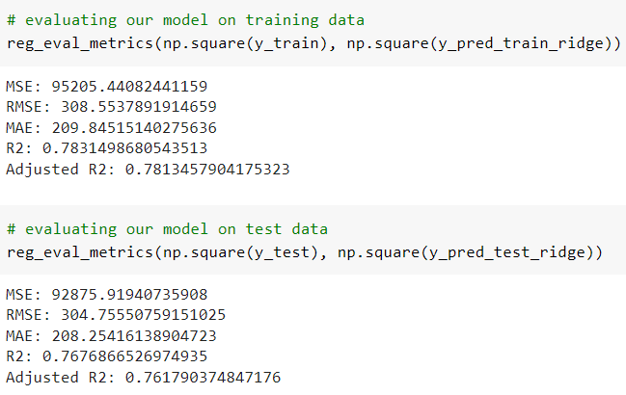
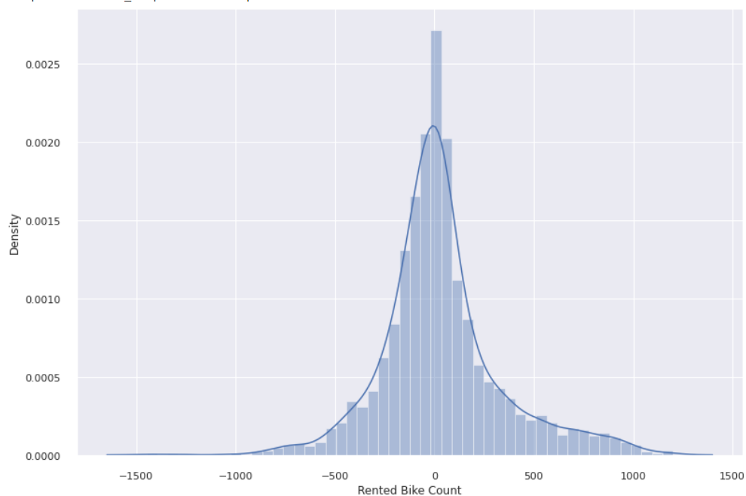
Ridge Regression
We can see that residuals are normally distributed when we use ridge regression.

Slide 25
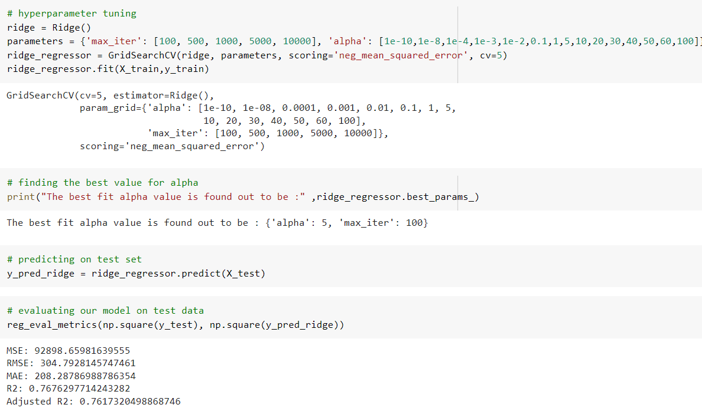
Hyperparameter tuning on Ridge Regression
After hyperparameter tuning
there is no significant change
in R2-score for ridge regression.
The RMSE and MAE are almost same before and after tuning.
The distribution of residuals is also normal distribution.

Slide 26
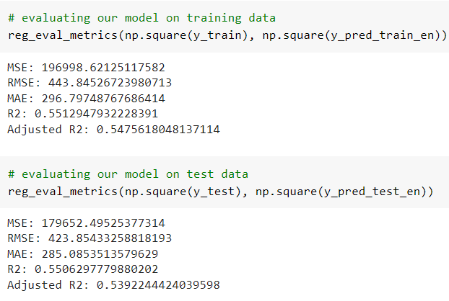
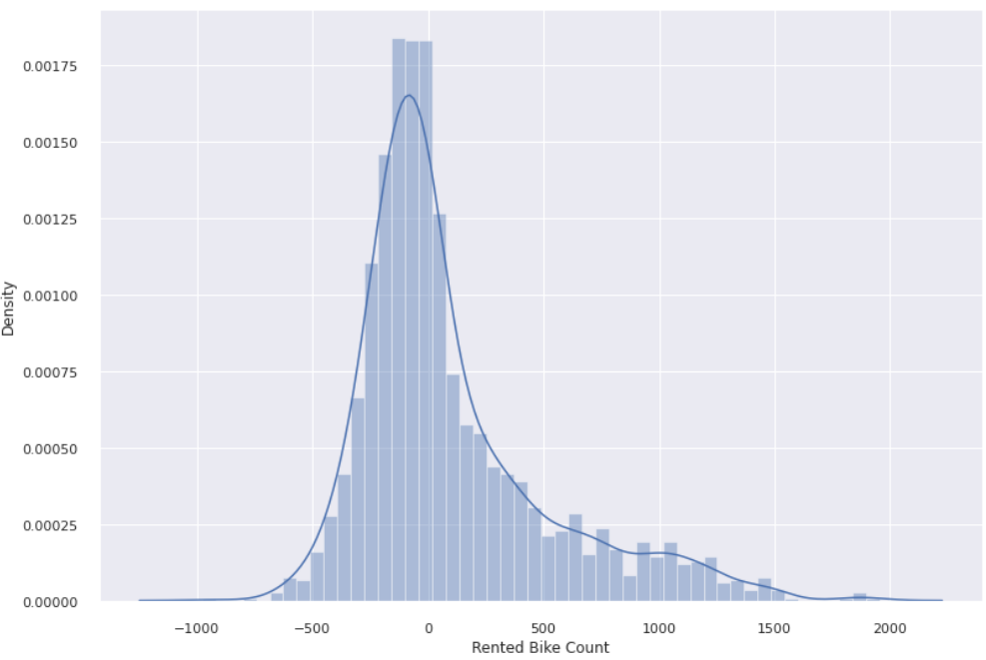
Elastic net
R2 score is low.
There is positive skewness in the distribution of residuals for elastic net.

Slide 27
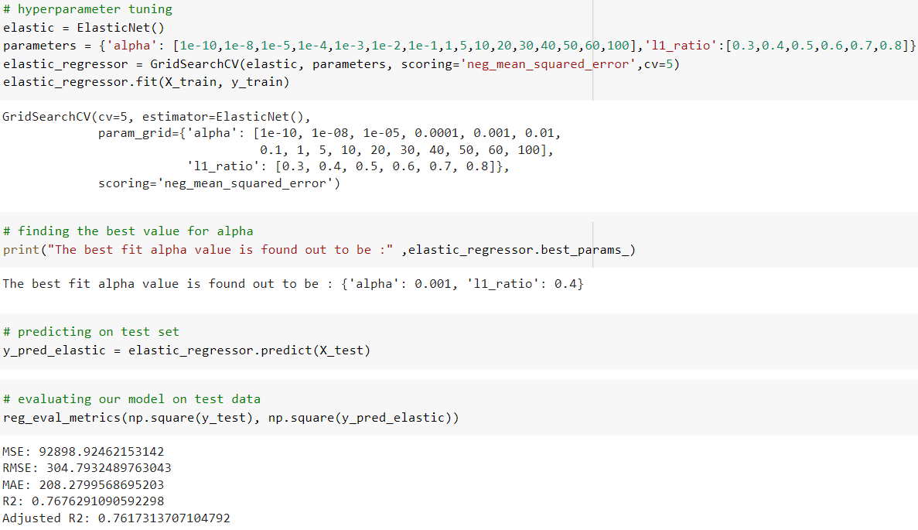

Hyperparameter Tuning on Elastic net
R2 score for elastic net increased by 20%.
For all the regularization techniques,
R2 score comes out to be around 0.76.
RMSE and MAE is also the same.
Now the residuals are normally distributed.

Slide 28
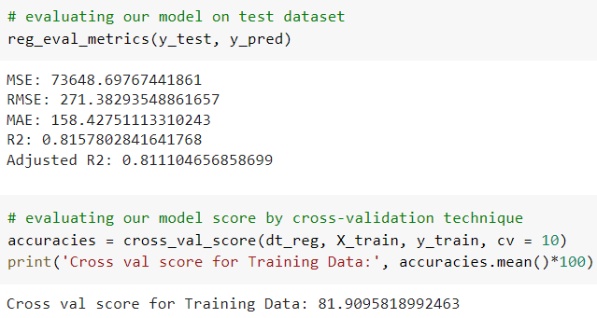
Decision Tree Regressor
Unlike linear regression, decision trees have no prior assumptions, so we don't have to standardize our variables. Plus we don't have to take the square-root of our dependent variable to make it normally distributed.
R2 score is more than other regression techniques by 5%.

Slide 29
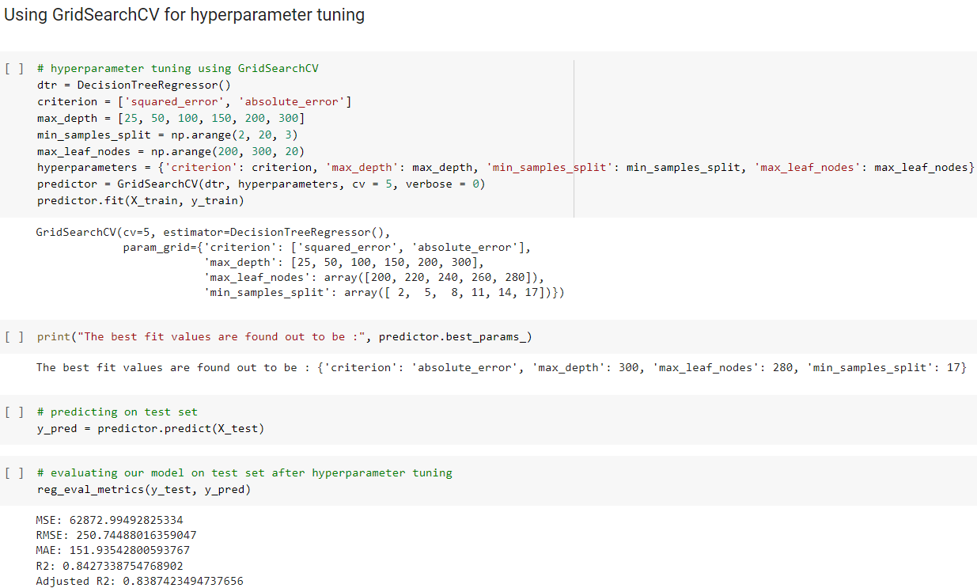
Hyperparameter Tuning on Decision Tree
We can see that the
R2 score for the decision tree increased by 3% after hyperparameter tuning.
RMSE and MAE values are also got reduced.

Slide 30
Model comparison
S.No | Algorithm | RMSE | RAE | R2 | Adjusted R2
1. | Linear regression | 304.39021 | 208.32013 | 0.76824 | 0.76236
2. | Polynomial regression (2nd degree) | 186.33570 | 117.37459 | 0.91315 | 0.91094
3. | Lasso regression | 304.78331 | 208.25760 | 0.76764 | 0.76174
4. | Ridge regression | 304.79281 | 208.28786 | 0.76762 | 0.76173
5. | ElasticNet | 304.79324 | 208.27995 | 0.76762 | 0.76173
6. | Decision tree regressor | 250.74488 | 151.93542 | 0.84273 | 0.83874

Slide 31
Conclusion
People prefer rented bikes when the temperature is high and humidity is low.
When there are no holidays, the demand is high specifically around 8 am and 6 pm. When there are holidays the demand is quite low during the entire day.
People like to take rented bikes when rainfall and snowfall are low.
During the entire day, the demand is high in the morning and even higher in the evening which shows employees mostly prefer rented bikes before and after their working hours.
The demand is high in summer especially in the month of June followed by July and May whereas the demand is lowest in the winter season i.e. during the month of December, January and February.

Slide 32
Contd.
The R2 score for linear regression and all the regularization techniques like lasso, ridge and elastic net is almost the same, around 0.76.
For decision tree, the R2 score comes out to be 0.84. Also, the RMSE and MAE are comparatively low from other regression algorithms.
2nd-degree polynomial regression has the highest value of R2 score of around 0.91 which means there is a non-linear relationship between the dependent and independent variables. It has also got the lowest RMSE and MAE values among all the models.

